Slide 1
M3

Slide 2
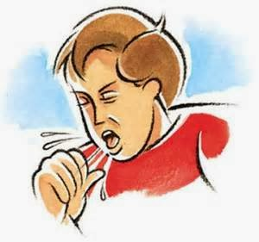
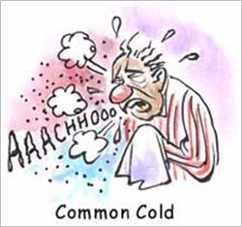

Chronic diseases and poor health
Acute and chronic diseases have different effects on our health.
Any disease that causes poor functioning of some part of the body will affect our general health as well.
But an acute disease, which is over very soon, will not have time to cause major effects on general health, while a chronic disease will do so.
As an example, think about a cough and cold, which all of us have from time to time.
Most of us get better and become well within a week or so.
And there are no bad effects on our health.
We do not lose weight, we do not become short of breath, we do not feel tired all the time because of a few days of cough and cold..

Slide 3



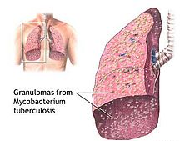

Chronic diseases and poor health
But if we get infected with a chronic disease such as tuberculosis of the lungs,
We may not go to school for a few days if we have an acute disease.
But a chronic disease will make it difficult for us to follow what is being taught in school and reduce our ability to learn.
In other words, we are likely to have prolonged general poor health if we have a chronic disease.
Chronic diseases therefore, have very drastic long-term effects on people’s health as compared to acute diseases.
then being ill over the years does make us lose weight and feel tired all the time.

